Slide 1


Breakout game using Matter over Thread
By Bart Gysen

Slide 2
Goals
Knowledge
Demo

Slide 3
Contents
Project overview
Matter
OpenThread
Game controller
Matter controller
Breakout game
Q&A

Slide 4
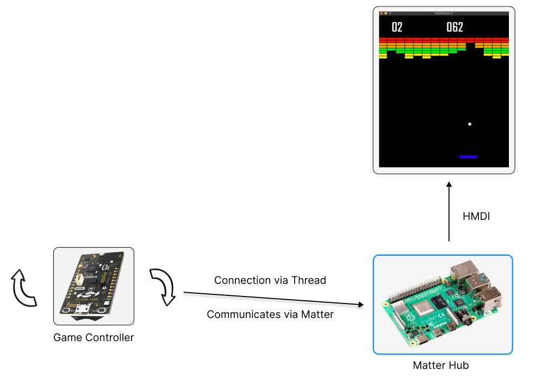
Project overview
Matter interactive demo
Breakout game
Controlled with motion
Notes:
Waarom protocol misbruikt?

Slide 5
Matter - contents
About
Architecture
Data Model
Interaction Model
Network
Security
Commissioning
Hub & Bridge
CSA membership & certification
Develop with Matter

Slide 6
Matter - About
Open source connectivity standard for the smart home
Connectivity Standards Alliance
Connected Home over IP (CHIP)
interoperability and compatibility
Reliability
Secure
First official release V1.0 in September 2022
Release V1.1 in May 2023 – bug fixes and SDK improvements
Release V1.2 in October 2023 – expanding with new device types
Notes:
CSA formerly Zigbee Alliance Rebranding in 2021

Slide 7
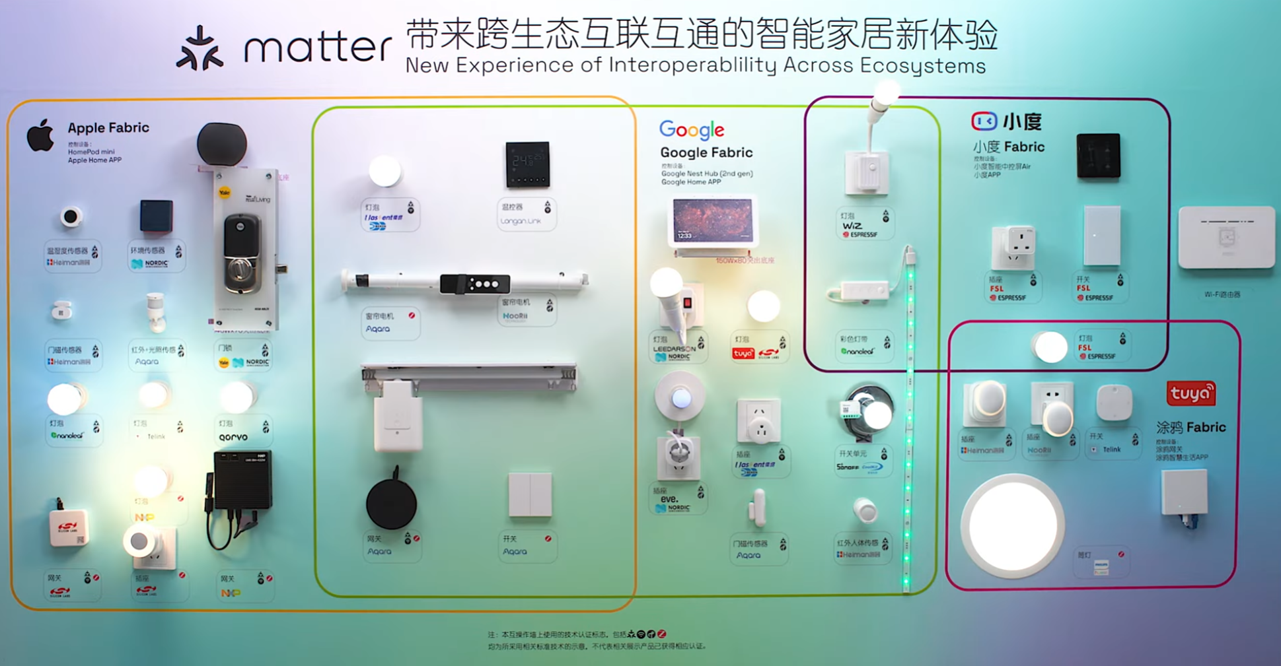
Notes:
Vermeld de CSA!!!

Slide 8
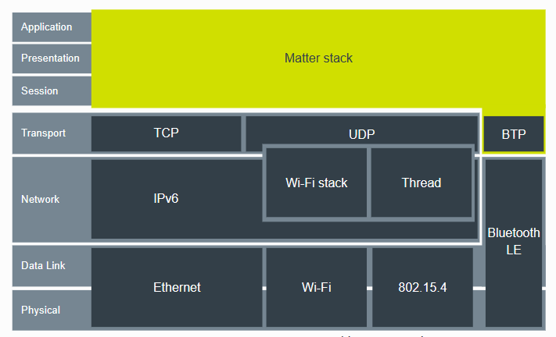
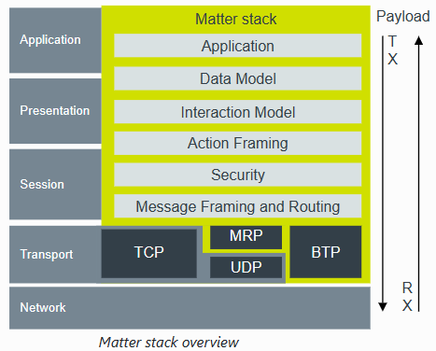
Matter – Architecture
Notes:
Core on the top three layers
can run over any type of IPv6 transport and network

Slide 9
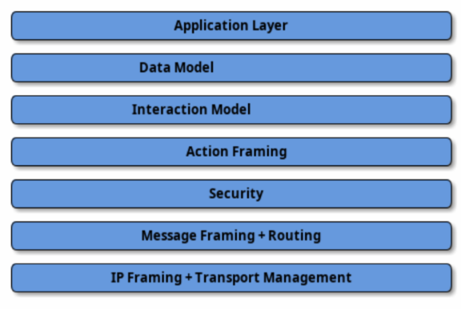
Matter – Architecture
STUDY THIS!!!!!
Notes:
Divided into layers

Slide 10
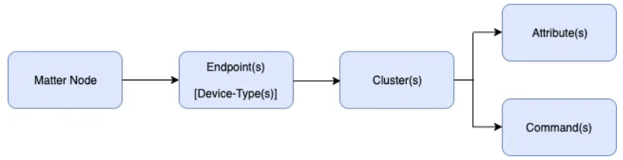
Matter – Data Model - Concept
Hierarchical model
Device features

Slide 11
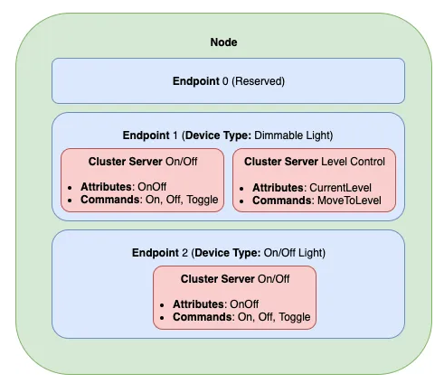
Matter – Data Model - Concept
Hierarchical model
Uniquely addressable entity
One or more endpoints
Set of behaviors
Dimmable Light
Dimmer Switch

Slide 12
Matter – Data Model - Endpoint
Set of functionality’s
On/Off
Level Control
Contains clusters

Slide 13
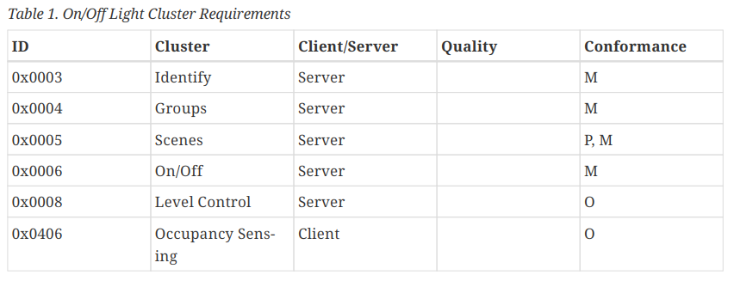
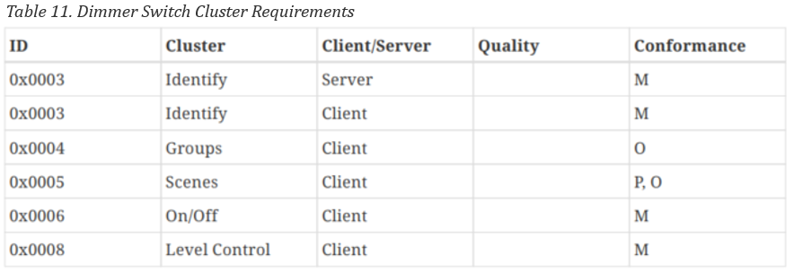
Matter – Data Model – Device Type
Officially defined collection of requirements
Intended to ensure interoperability
Device library specification

Slide 14
Matter – Data Model - Concept
Hierarchical model
Uniquely addressable entity
One or more endpoints
Set of behaviors
Dimmable Light
Dimmer Switch

Slide 15
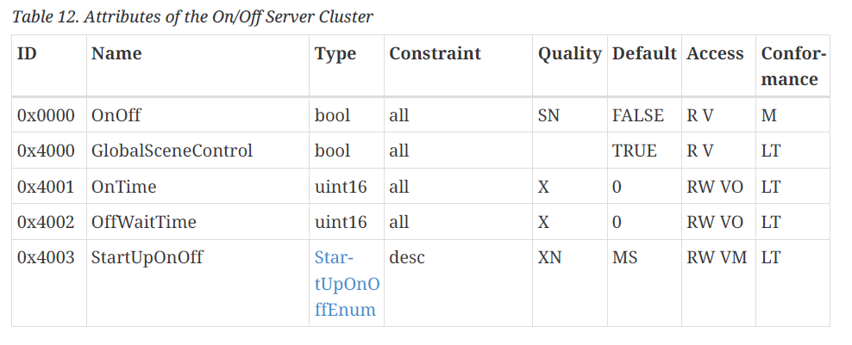
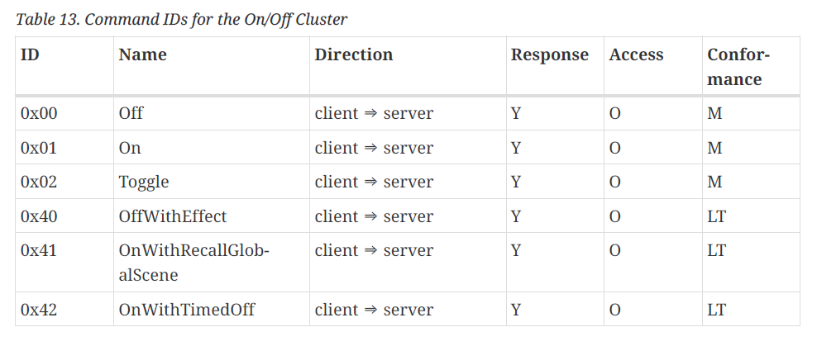
Matter – Data Model - Cluster
Reusable building blocks
Grouping commonly used functionality
Application cluster specification

Slide 16
Matter – Data Model – Custom Cluster
Designed to add functionalities
Reusing or extending a existing cluster will only work with custom controller
A new cluster specification only possible with a least an adoption-level member

Slide 17
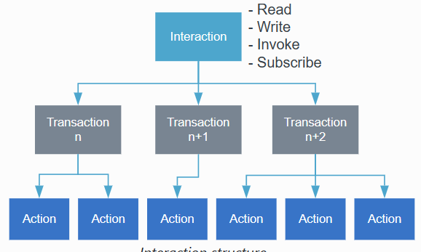
Matter – Interaction Model
Defines the methods of communication
Initiators - Targets
Notes:
Every interaction except Subscribe consists of one transaction

Slide 18
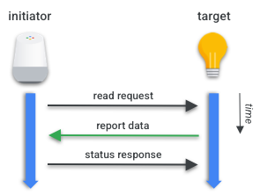
Matter – Interaction Model – Read
Get attributes and/or events
Restricted to unicast
Initiator requests a list of attributes and/or events
Target responds with requested list and a suppress response flag
Initiator generates a status response, not send when suppress response flag is set

Slide 19
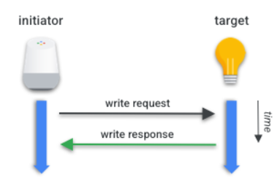
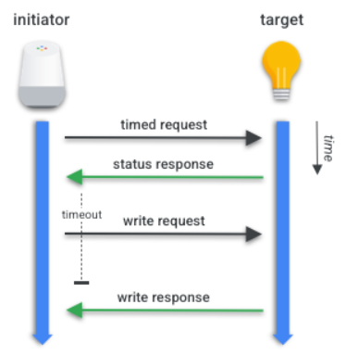
Matter – Interaction Model - Write
Modify values of attributes
Untimed or Timed transaction
Untimed two actions
Timed four actions
Notes:
Write action = Write request, Timed Request, Suppress Response flag

Slide 20
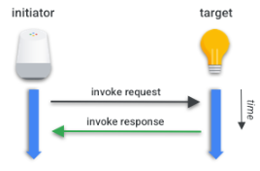
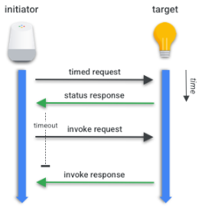
Matter – Interaction Model - Invoke
To invoke commands
Similar to write interaction
Untimed / Timed
Notes:
Used for e.g. By the controller to invoke one of the commands of the data link layer.

Slide 21
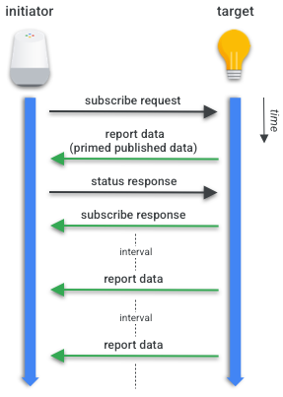
Matter – Interaction Model - Subscribe
Used to automatically receive updates
Restricted to unicast
Will be checked with status and subscribe response

Slide 22
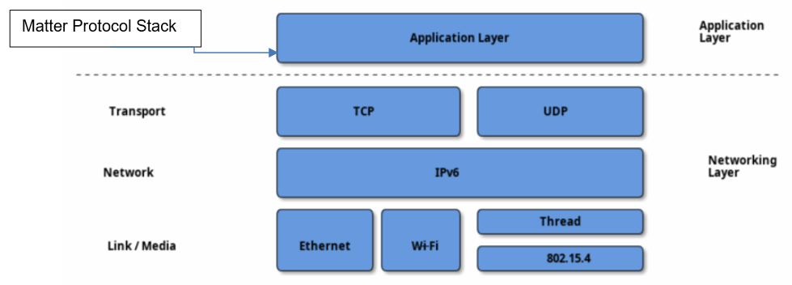
Matter – Network
IPv6
Focus on three link layer technologies
Single Network Topology
Star Network Topology

Slide 23
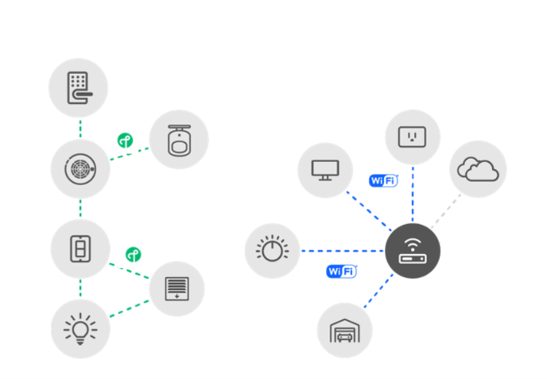
Matter – Network – Single Network Topology

Slide 24
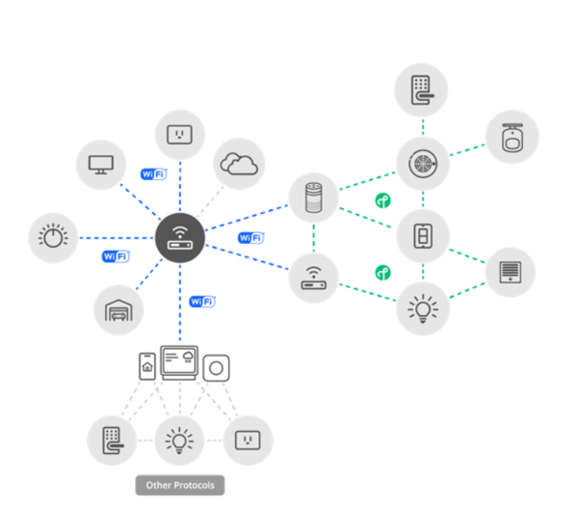
Matter – Network – Star Network Topology

Slide 25
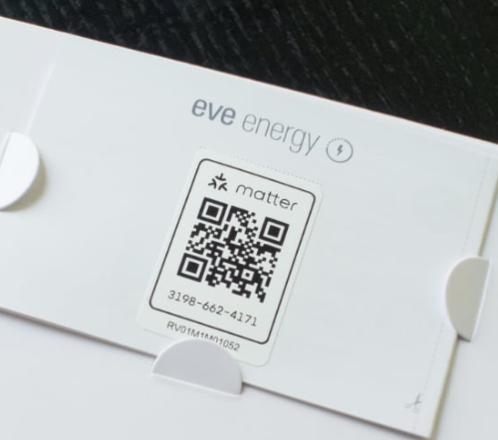
Matter - Commissioning
Pairing method
Performed over BLE
Controller needs onboarding payload:
QR Code
QR Code Payload used in command line tools
Manual pairing code

Slide 26
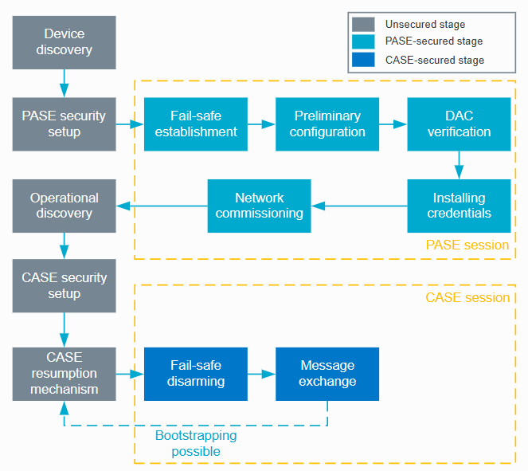
Matter - Commissioning

Slide 27
Matter – Fabric
The whole network
Sharing the same security domain

Slide 28
Notes:
Vermeld de CSA!!!
XIAUDU

Slide 29
Matter – Multiple Fabrics
Notes:
Specification

Slide 30
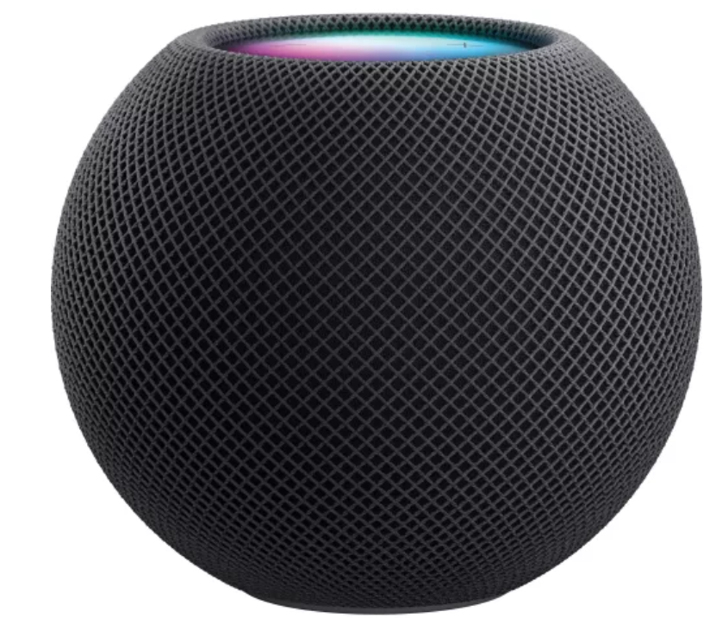
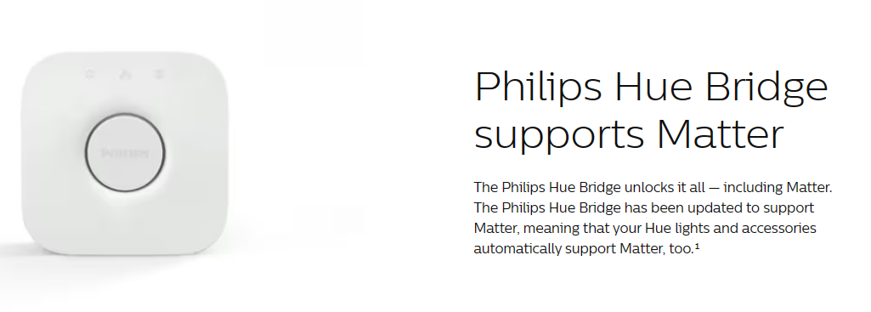
Matter – Hub & Bridge
Hub
Bridge
Serves as controller
Not tied to ecosystem
Often functions as Border Router
Add more flexibility
Acts as translator for non-Matter devices
Notes:
Hue -> Zigbee

Slide 31
Matter – CSA Membership & certification
Membership necessary for certifying
Official resources
Authorization to contribute
Unique Vendor ID

Slide 32
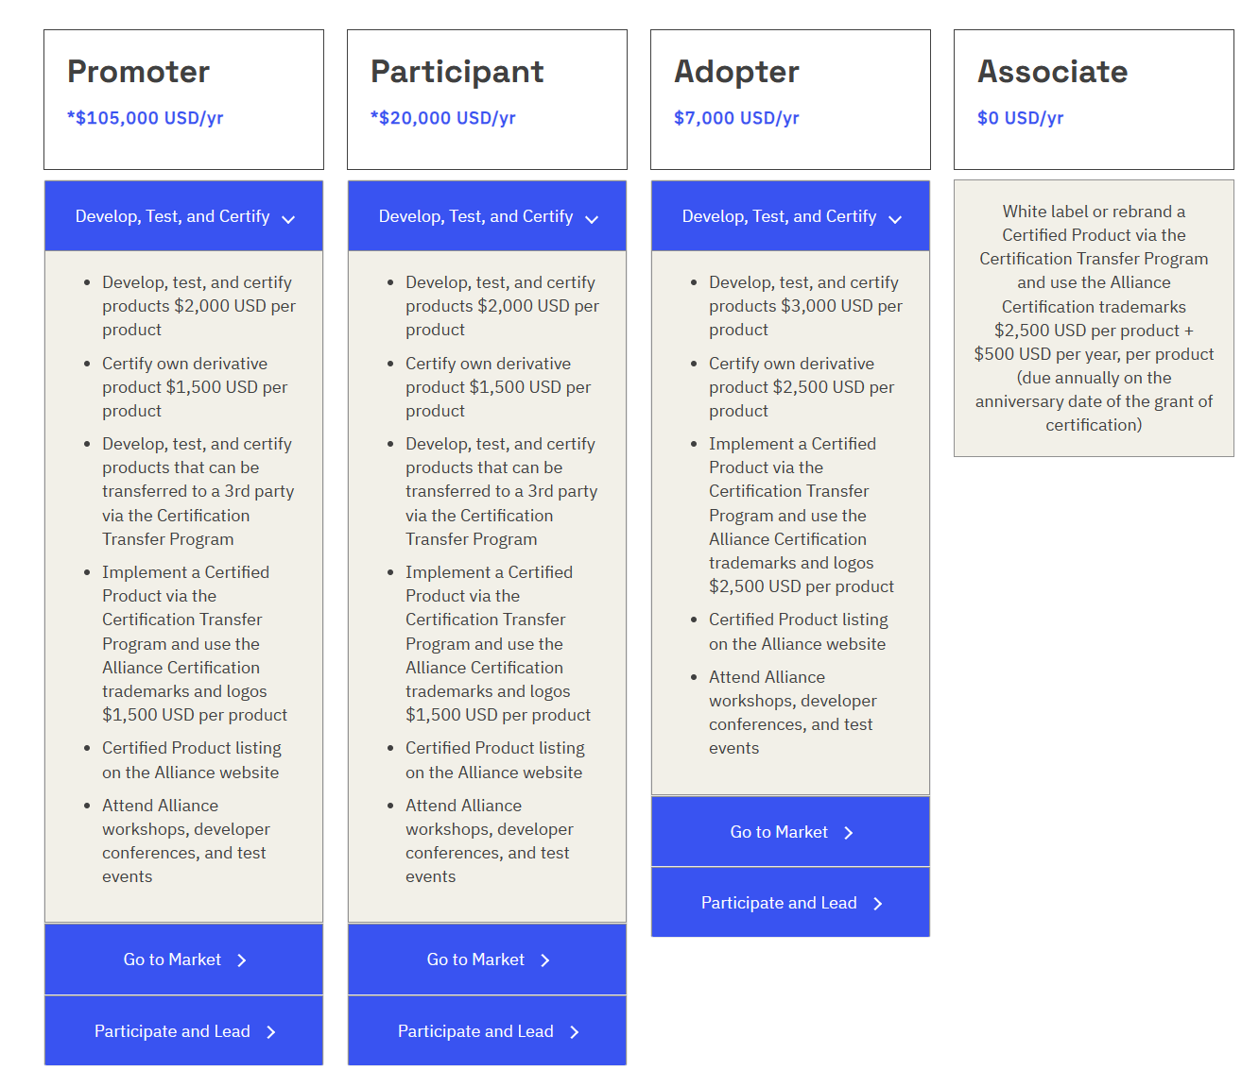

Slide 33
Matter – Develop with Matter
GitHub project-chip
SDK
Documentation
Certification tool
Manufacturer SDK
Manufacturer IDE
A lot of examples you can use

Slide 34
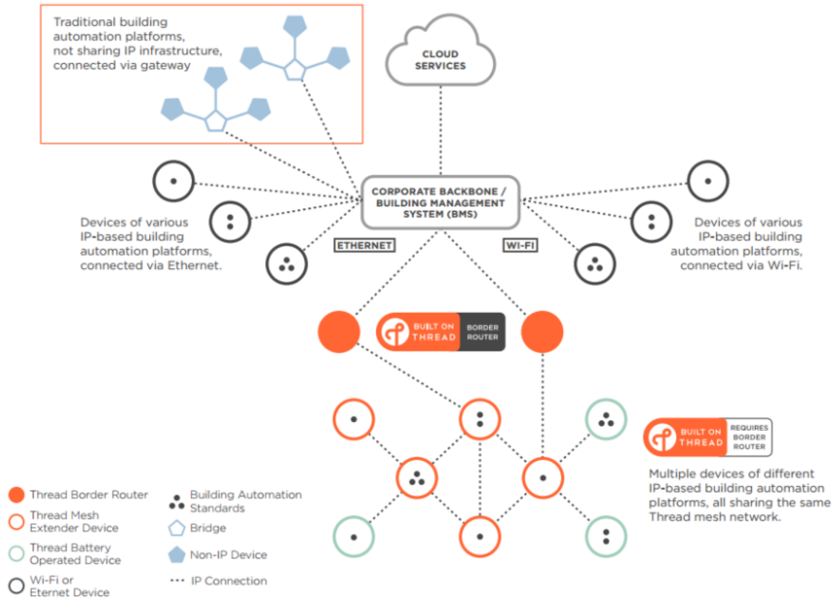
OpenThread
Mesh Network-protocol
IEEE 802.15.4
IPv6
Low-power
Border Router
Notes:
Institute of Electrical and Electronics Engineers

Slide 35
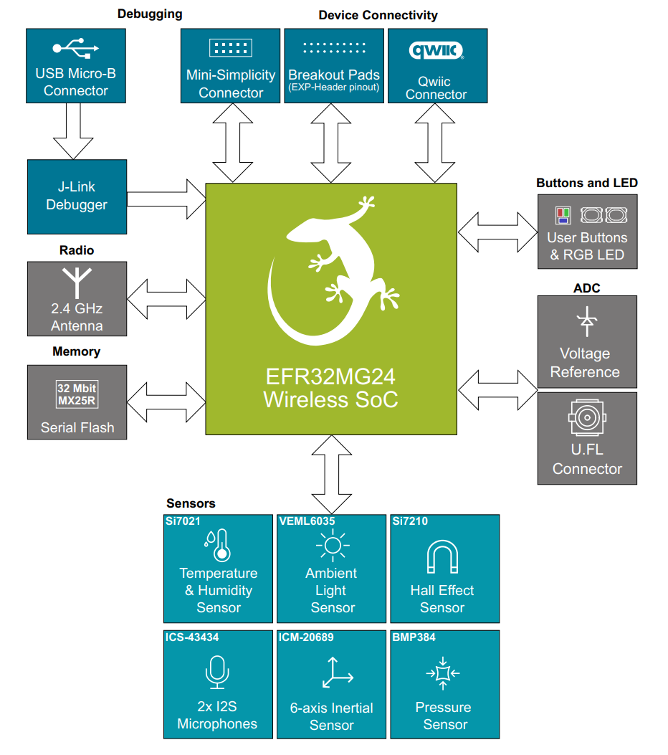
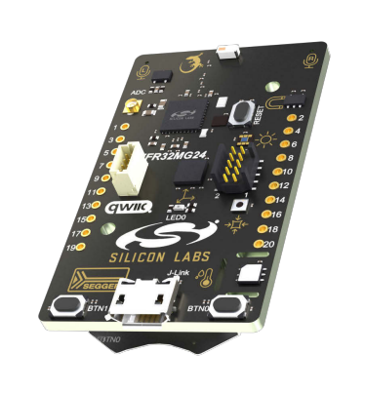
Game Controller
EFR32MG24 SoC - BRD2601B All-in-one-Solution
No device type available
To make it work, we need to be creative
Using On/Off sensor with level control
Consideration Client vs. Server
Notes:
Kreatief geweest met het protocol

Slide 36
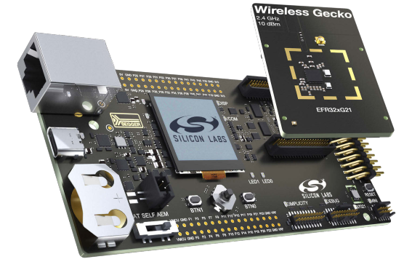
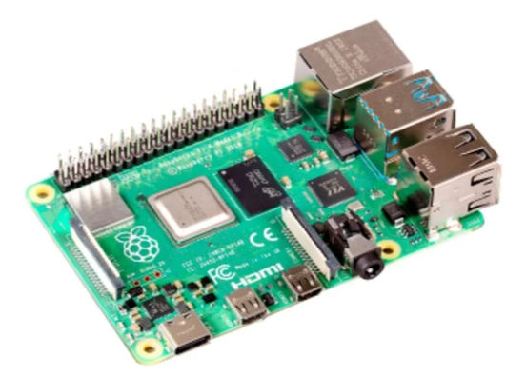
Matter Controller / Hub
Raspberry Pi 4
Radio Co-Processor EFR32xG21
Ubuntu with CHIP-Tool and OpenThread
Python Breakout game
Notes:
RCP omdat dit de main processor ontlast.

Slide 37
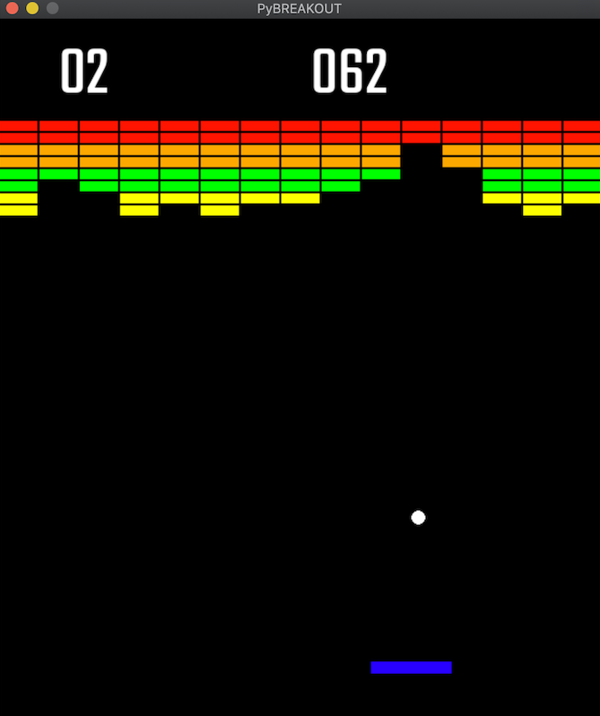
Breakout game
Python Game from GitHub and heavily modified
CHIP-Tool to interact
Subscribe transaction to get value
Subprocess and threading

Slide 38
Q&A

